Slide 1
Capstone project Movie Rental Data Analysis
Name: Nishanthi. A
Mentor: Jaya Pandey
Batch: DA22S2

Slide 2
OBJECTIVE
The aim of this project is to provide the management of movie on rent with actionable insights and data-driven recommendations for stocking their inventory.
By understanding the most frequently rental movies,popular genres,actors in demand ,and the management can make informed decisions about which movies to stock in their stores.
This,in turn,aims to improve the customer satisfaction by offering a wide selection of movies that align with customer preferences.
Also,enhance business profitability by optimizing inventory management and increasing movie rentals.

Slide 3
DESCRIPTION
Schema-Sakila Database.
In this dataset, we have 18 tables.
For my analysis,I have considered the tables actor, film, category, film category, film actor, rental, inventory.
Actor table contains actor_id and name of the actors.
Film table contains film_id, title, rental_rate, replacement_cost, rating, duration_length.
Category name contains category_id,category name in which the movie belongs and last updated columns.

Slide 4
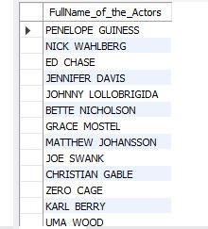
Task1: Display the full names of the actors available in the database.
Output
Technique
Interpretation
Select,
Concat()
There are around 200 actors in the dataset and full name has displayed using concat() function.

Slide 5
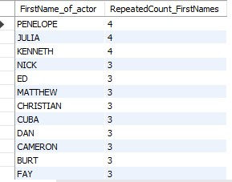
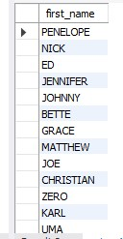

Task2:(i) Display the number of times each first name appears in the database. (ii)What is the count of actors that have unique first name I the database? Display the first name of all these actors.
Technique Output
Interpretation
Select,
Distinct,
Group by,
Order by
The first name Penelope, Julia, Kenneth has appeared around 4 times.
There are total 128 who have unique first names in the database.

Slide 6
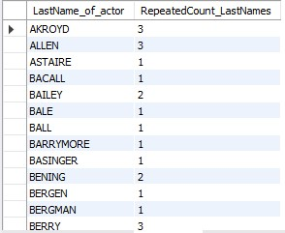
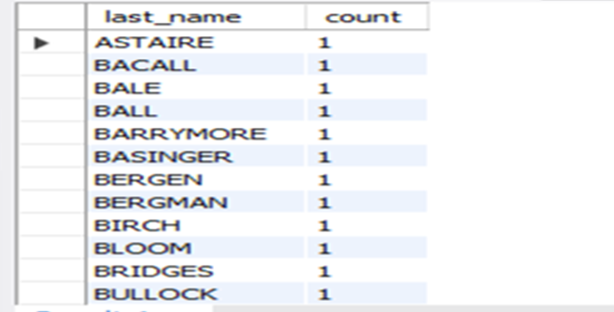
Task3:(i) Display the number of times each last name appears in the database. (ii) Display the last name of all these actors.
Output
Technique
Interpretation
Select,
Distinct,
Group by,
Order by
The last name Akroyd, Allen has appeared around 3 times.
There are total 128 who have unique last names in the database.

Slide 7
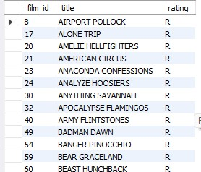
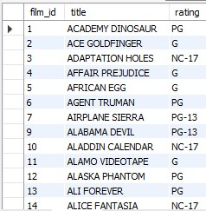
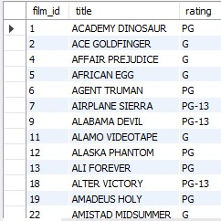
Task4: (i)Display the list of records for the movies with the rating ‘R’ (ii) Display the list of records for the movies that are not rated ‘R’ (iii) Display the list of records for the movies that are suitable for audience below 13 years of age.
Output
Technique
Interpretation
Select,
Where
1.There are total 195 movies having rating ‘R’ and 805 movies that are not rated ‘R’.
2.I have considered the rating ‘G’,’PG’ and ‘PG-13’ for below 13 years of age and there are total 595 movies.

Slide 8
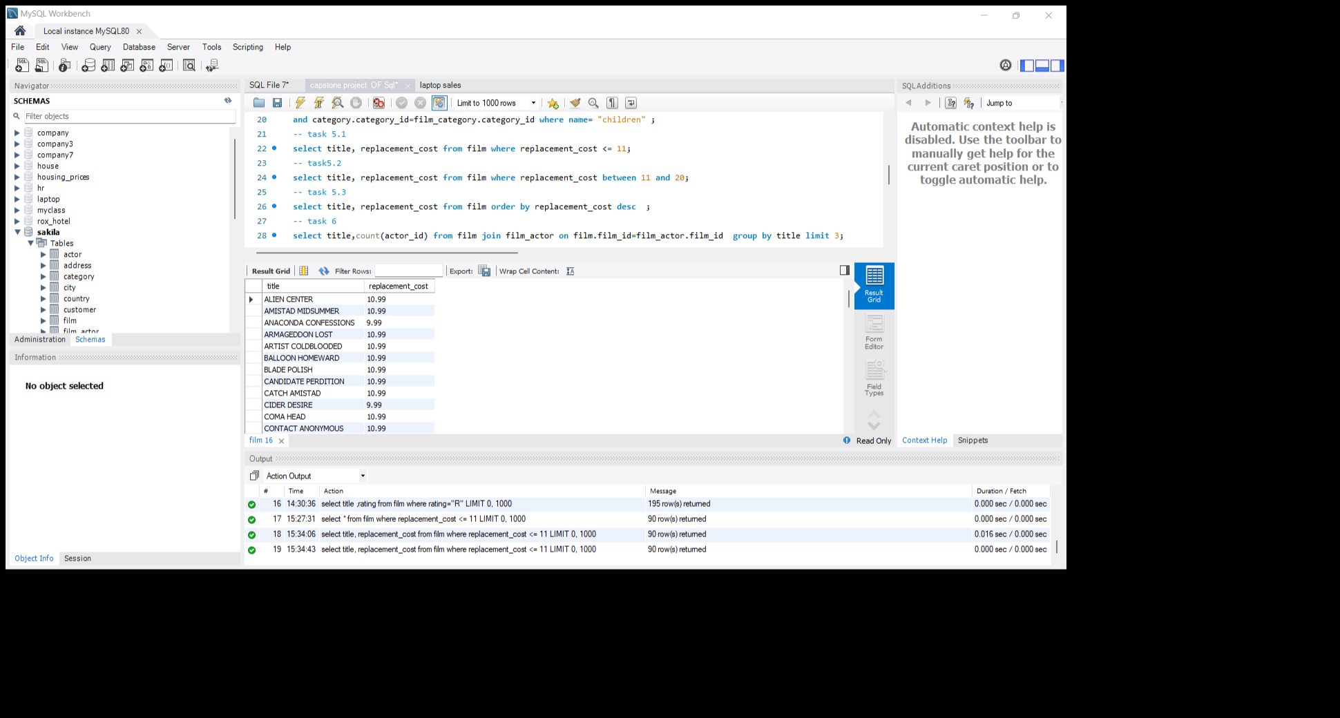
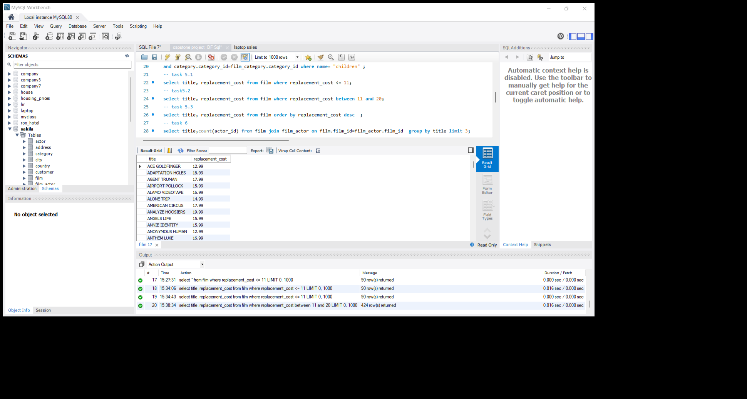
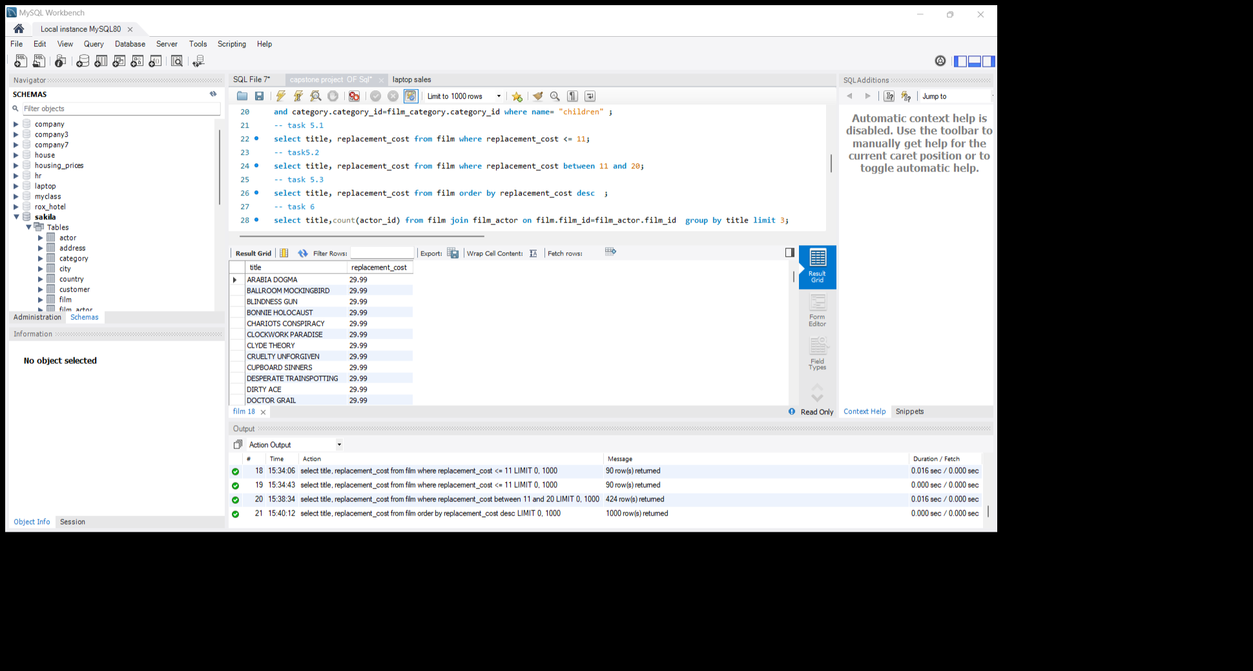
Task5: (i)Display the list of records for the movies where the replacement cost is upto $11. (ii)Display the list of records for the movies where the replacement cost is between $11 and $20. (iii)Display the list of records for all the movies in decending order of their replacement costs.
Technique Output
Interpretation
Select,
Where,
Between,
Order by
There are 90 movies having the replacement cost is less than $11.
There are 424 movies having the replacement cost between $11 and $20.

Slide 9

Task6: Display the names of the top 3 movies with the greatest number of actors.
Technique Output
Interpretation
Select, Join,
Group by,
Order by, Limit
I have joined the film,film_actor,actor tables using film_id and actor_id.Here, Lambs cincinatti have a maximum count of actors.

Slide 10


Task7: Display the titles of movies starting with the letters ‘K’ and ‘Q’
Output
Technique
Interpretation
Select,
Where,
Like
There are 12 movies starting with the letter ‘K’ .
There are 3 movies starting with the letter ‘Q’

Slide 11
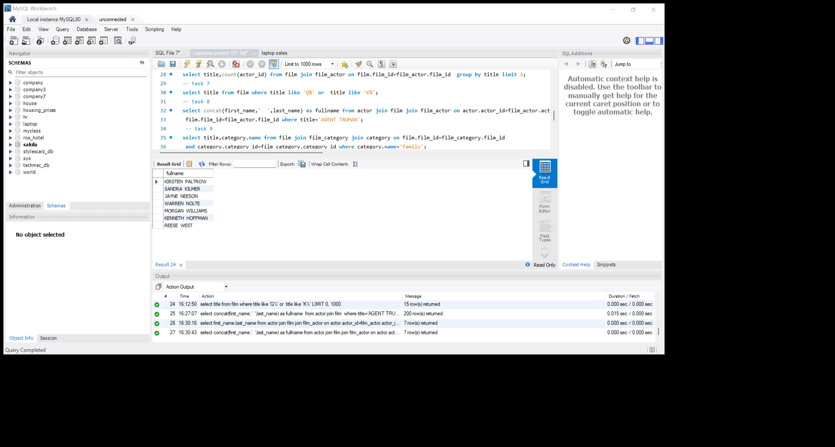
Task8: Display the names of all actors where the movie name is ‘Agent Truman’
Output
Technique
Interpretation
Select,Concat,
Join,Where
I have joined the film,film_actor,actor tables using film_id and actor_id.There were 7 actors in the movie called ‘Agent Truman’ and full name of the actors has displayed by using concat function.

Slide 12
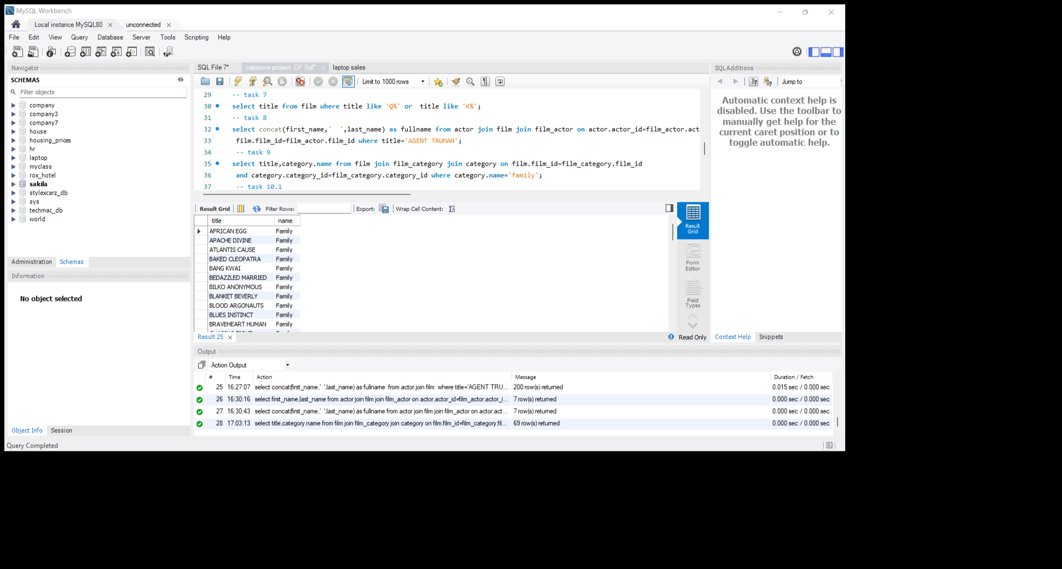
Task9: Identify all the movies categorized as family films.
Output
Technique
Interpretation
Select,
Join,
Where
I have joined film,film_category,category tables.There are total 69 movies belongs to family category.

Slide 13
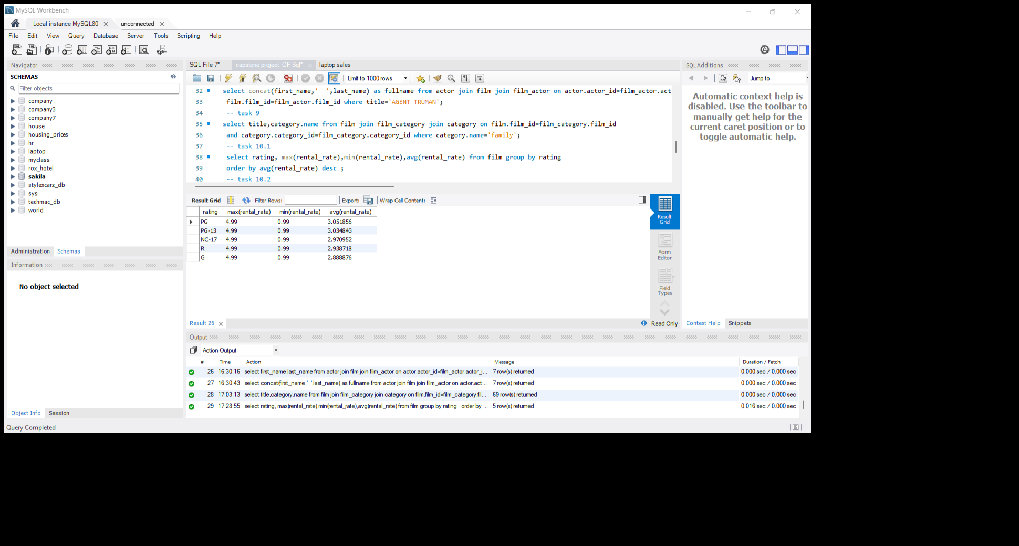
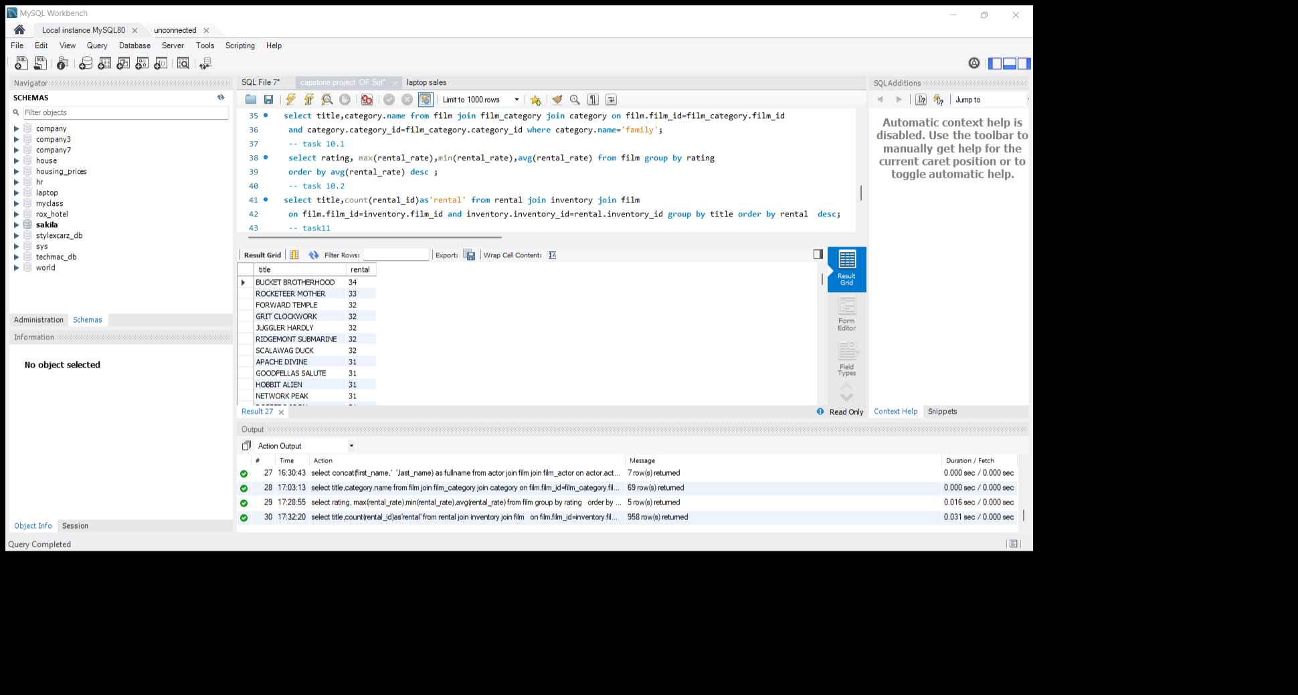
Task10:(i)Display the maximum, minimum and average rental rates of movies based on their ratings. The output must be in descending order of the average rental rates (ii)Display the movie in descending order of their rental frequencies, so the management can maintain more copies of those movies
Technique Output
Interpretation
Select,max(),min(),avg() Join,
Group by,
Order by
I have joined film,inventory,rental tables.The average rental rate is highest in ‘PG’ rating with 3.051 and maximum rental rate is 4.99 and minimum rental rate is 0.99.
The most frequently rented movie is ‘Bucket Brotherhood’ and it has rented 34 times .

Slide 14
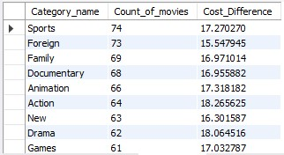
Task11: (i) In how many film categories, the difference between the average film replacement cost ((disc- DVD/Blue Ray ) and film rental rate is greater than $15. (ii) Display the list of all film categories identified above ,along with the corresponding average film replacement cost and average film rental rate.
Technique Output
Interpretation
Select, Join,
Group by, Having,
Order by
Here,I have joined film,film_category and category tables.Therfore,Sports category has maximum number of movies with total count of 74 and their cost difference is 17.27 and second highest count of movies is foreign category.

Slide 15

Task12: Display the film categories in which the number of movies is greater than 70
Technique Output
Interpretation
Select,
Join,
Group by,
Having
Here,I have joined the film,film_category, and category tables.The film category foreign and sports are having the number of movies greater than 70.

Slide 16
Conclusion:
In this database, there are 16 category, 1000 movies and 200 actors.
Most of the movies got ‘PG-13’(30%) rating and the average rental rate for the movies having ‘PG-13’ rating are 3.03
73% of the movies are having the replacement cost between $11 and $25.
‘Lambs Cincinatti’ have a maximum number of actors(15) followed by ‘Crazy Home’ and ‘Random Go’(13 actors).
The movie ‘Agent Truman’ got a great success,it has 7 actors and belongs to foreign genre and it has rental rate=2.99, replacement cost=17.99 and rating=‘PG-13’.
The movie ‘Bucket Brotherhood’ has frequently rented movie, it has rented around 34 times belongs to travel genre and having the ‘PG’ rating.
‘Sports’ genre has maximum number of movies around 74 movies foreign genre has 73 movies, family genre has 64 movies and children genre has 60 movies.

Slide 17
Through my analysis, I would suggest to the movie rental store which category of movie that may contribute most profitable
Rating=‘PG’ and ‘PG-13’
Replacement cost between 15 to 25
Number of actors should be 6 to 10
Genre =Family, Children, Foreign, Travel and sports.
Rental rate between 2.5 to 3.5
The average length should be 110 to 125

Slide 18
Thank You

